Slide 1
Presentations: what we’re looking for
Your speech will be assessed by your teacher and your classmates in three ways:
Voice
Speaking clearly and confidently
Speaking at a good volume
What are some weaknesses that a presenter could have in this area?
What are some strengths that a presenter could have in this area?

Slide 2
Presentations: what we’re looking for
Your speech will be assessed by your teacher and your classmates in three ways:
Communication
Explaining your animal and its adaptations in an informative and interesting way
Giving a presentation that your audience wants to listen to and learns something from
What are some weaknesses that a presenter could have in this area?
What are some strengths that a presenter could have in this area?

Slide 3
Presentations: what we’re looking for
Your speech will be assessed by your teacher and your classmates in three ways:
Participation
Your presentation is your best work
If you are working in a pair, both members speak for a roughly equal amount of time
What are some weaknesses that a presenter could have in this area?
What are some strengths that a presenter could have in this area?

Slide 4
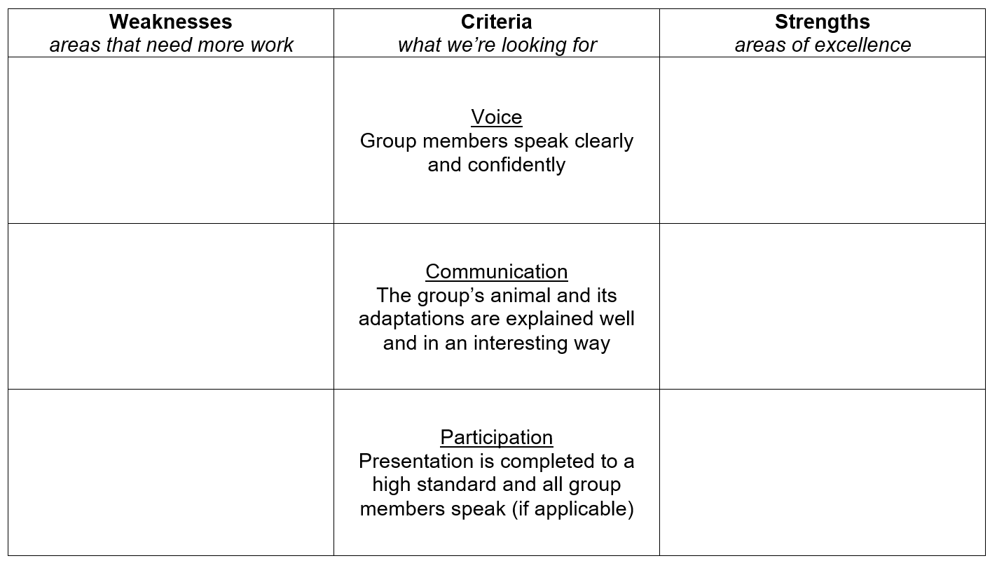
Presentations: the rubric
Your speech will be assessed using these:

